Slide 1
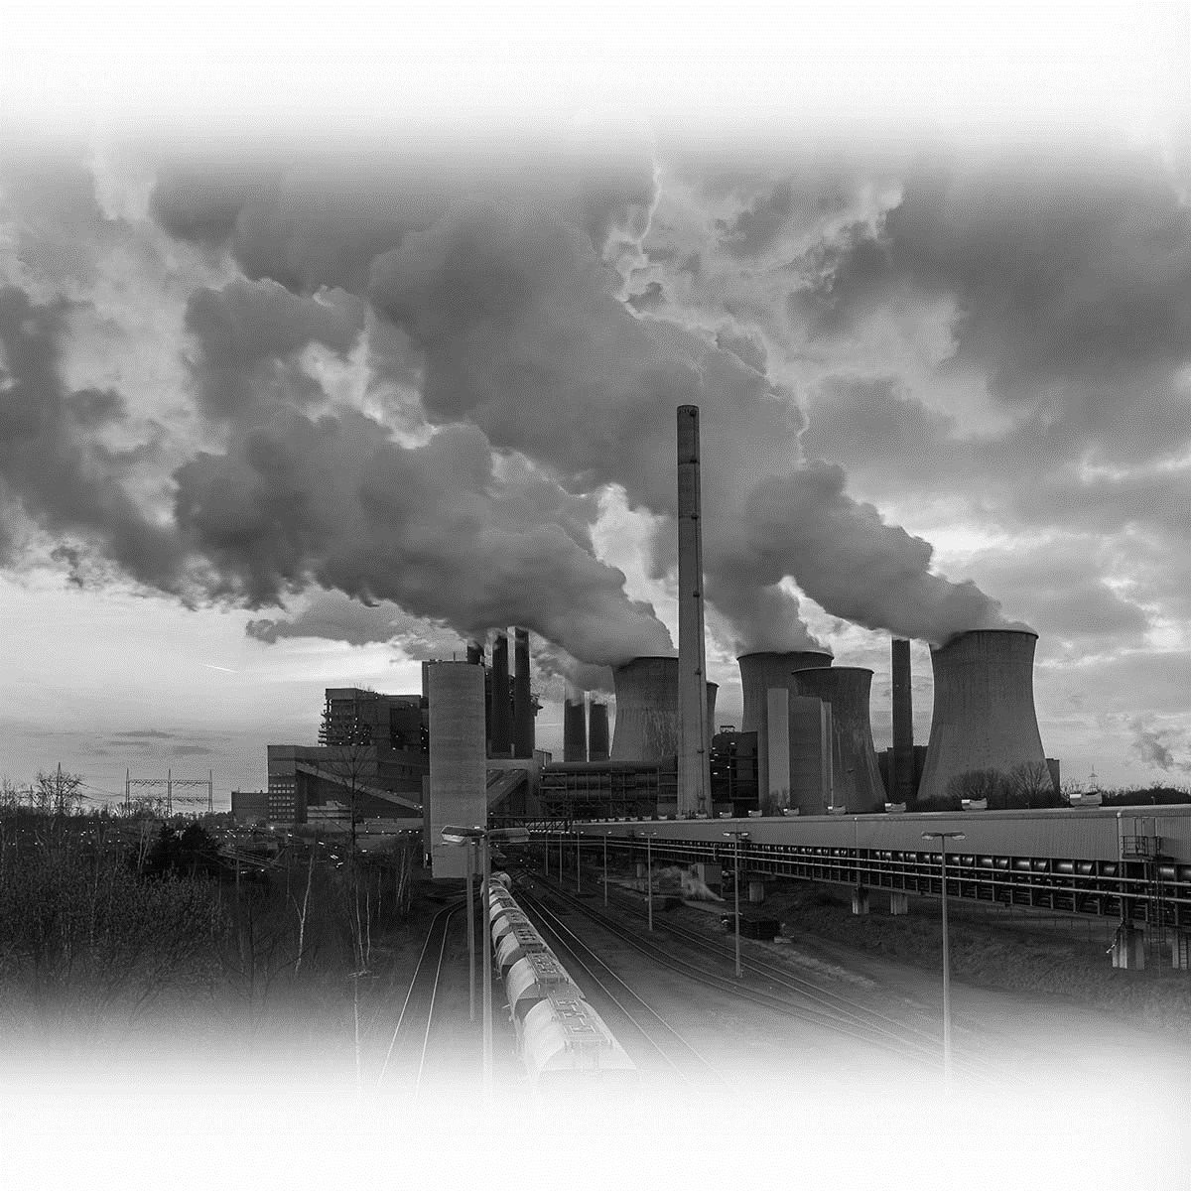
Time Series Forecasting of CO₂ Emissions
Kodjo Botchway
Rupom Bhattacherjee

Slide 2
WHOA!
“Adding CO₂ to the air is like throwing another blanket on the bed.”
- James Hansen
1

Slide 3
01
02
Study overview
Data Preparation
03
04
Modelling
Results & discussion
Predicting CO2 emission with time series
Transformation, stationarity check, removing non-stationarity
Tuning parameters for accuracy and selection of the forecasting models
Final forecasts and insights.
2

Slide 4
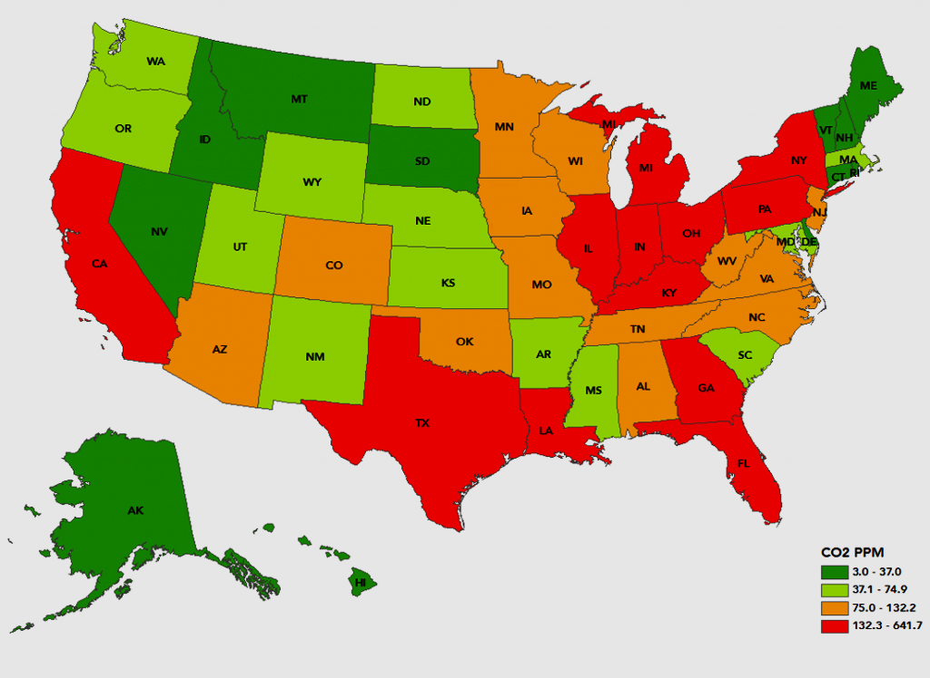
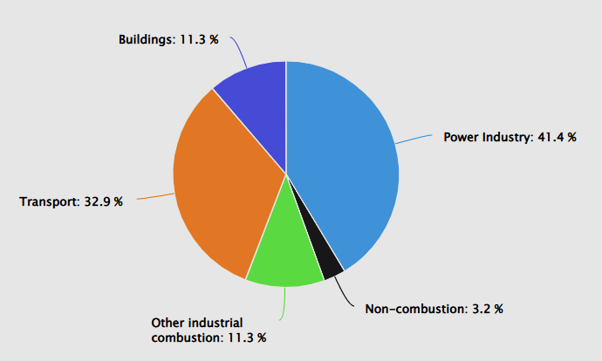
About CO₂ Emissions
Almost three-quarters of emissions come from energy usage
Energy related CO₂ emission levels in the United States during 2000-2020
https://www.digmap.com/blog/united-states-carbon-dioxide-emission-levels-state/
3
https://www.worldometers.info/co2-emissions/us-co2-emissions/

Slide 5
Why forecasting is needed!
Track emission
Proper Planning
Less CO2 = less costs
Identifying and quantifying potential sources of CO₂ emissions
Develop carbon measuring and reducing programs for companies
Identifying and quantifying CO₂ emissions helps identify excessive energy usage or other inefficiencies
4

Slide 6
Study Overview
Time series forecasting models to forecast carbon footprint for United States
Different matrices such as RMSE, MAPE, and MAE were used to compare models and select the best one
CO₂ emission data over the periods of 1990 to 2018 were used to make 5 years and 10 years forecasts
5

Slide 7

Business Problem
To forecast CO2 emission levels for different sectors so that
Emission levels are within standard limit
Organizations can follow government norms with respect to CO2 emission levels
6

Slide 8
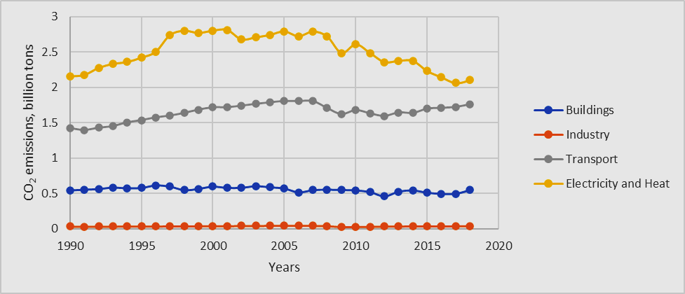
Data Overview
CO₂ emission data from:
Energy usage in residential and commercial buildings
Industrial, and chemical processes
Generation of electricity and heat
Transportation
Electricity and heat production dominates CO₂ emission, followed by transportation and buildings
7

Slide 9
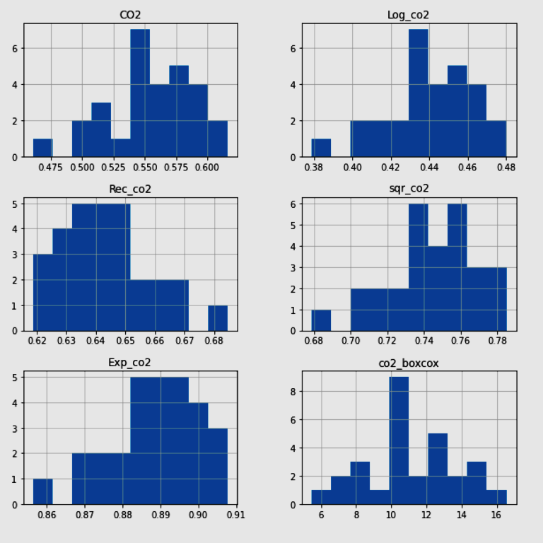
Data Preparation
Prepare data for time series modeling
Data converted to time series format
Distribution was not normal
Five different transformations were used
Log, Reciprocal, Square-Root, Exponential, and Box-cox
No conclusive evidence normal distribution after transformation
CO₂ emission from buildings before and after transformations
8

Slide 10
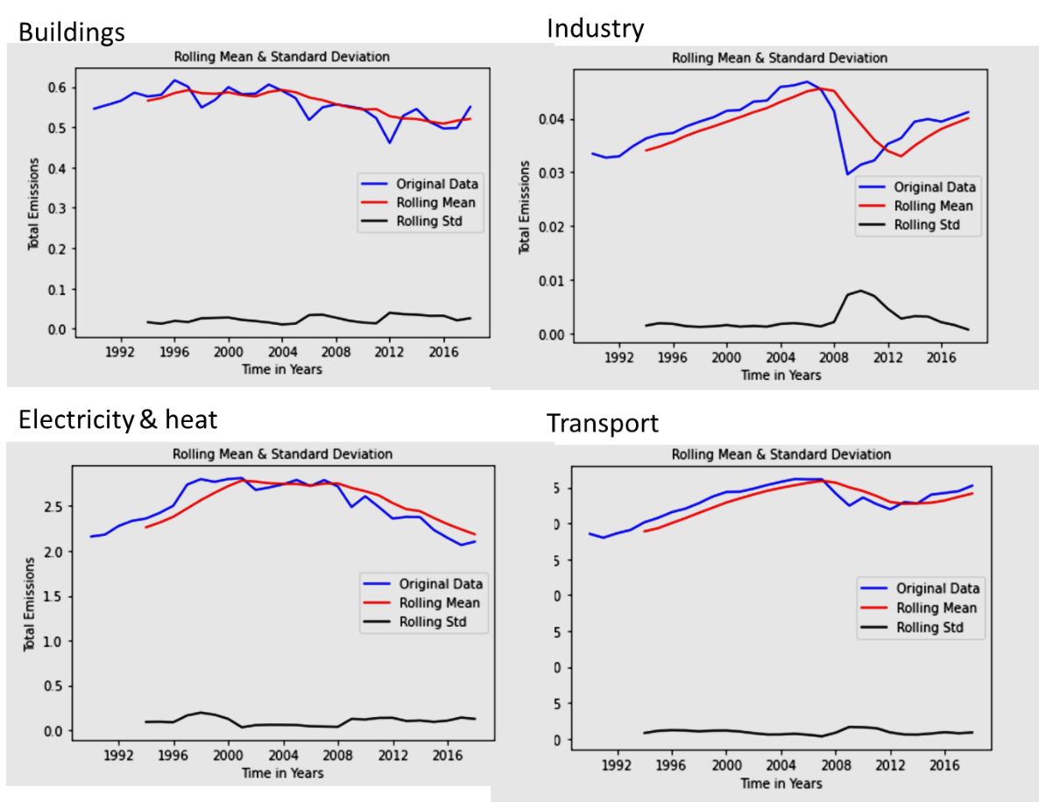
Data Preparation
Checking stationarity
Naïve test
Augmented Dickey Fuller
Rolling statistics
Sectors | Naïve Test Result | ADF test result
Buildings | μ₁=0.57, μ₂=0.53 | Stationary
Industries | μ₁=0.03, μ₂=0.03 | Stationary
Electricity and heat | μ₁=2.54, μ₂=2.46 | Stationary
Transport | μ₁=1.58, μ₂=1.7 | Stationary
Only Buildings indicates stationarity
9

Slide 11
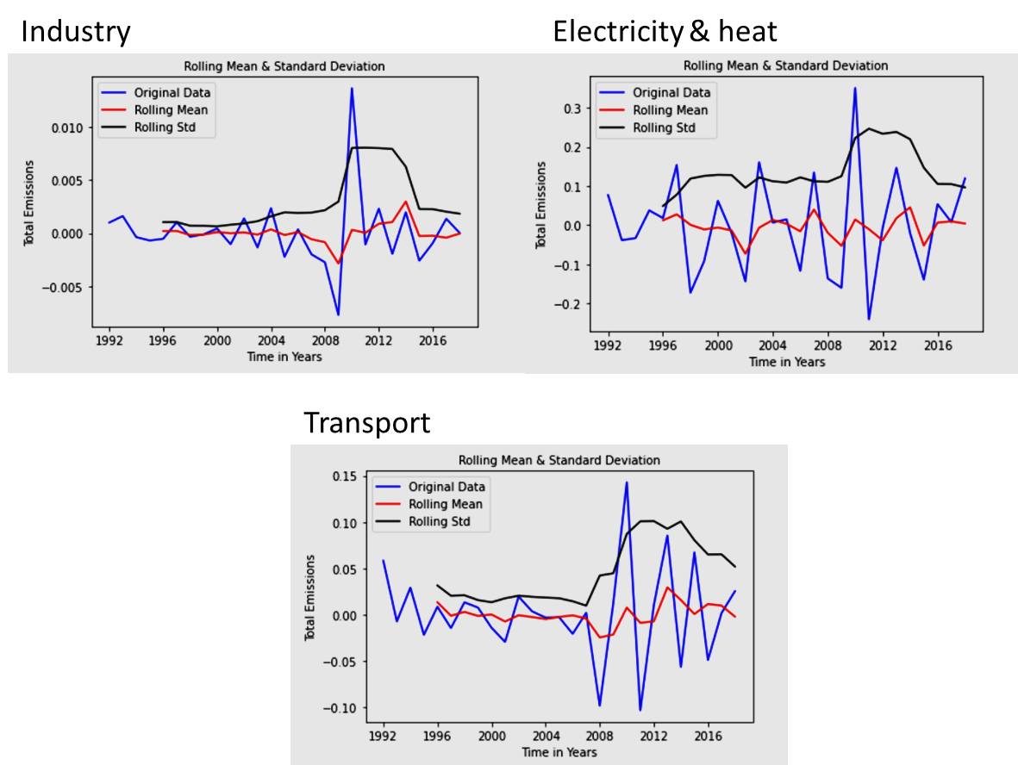
Data Preparation
Transforming data to stationary
Moving average smoothing
Window size of five years is selected
Differencing
Second order differencing demonstrated better stationarity
Rolling mean does not deviate much from a straight line
10

Slide 12

Modelling
For the forecasting predictions, following models were trained
Autoregressive Integrated Moving Average (ARIMA)
70:30 split between training and validation data
Auto Regressive (AR)
Moving Averages (MA)
Auto ARIMA
Hyper-parameter tuning was implemented to obtain best combination of levels, terms, and moving average
Autocorrelation (ACF) and partial autocorrelation (PACF) to identify the number of lags required for AR models
11

Slide 13
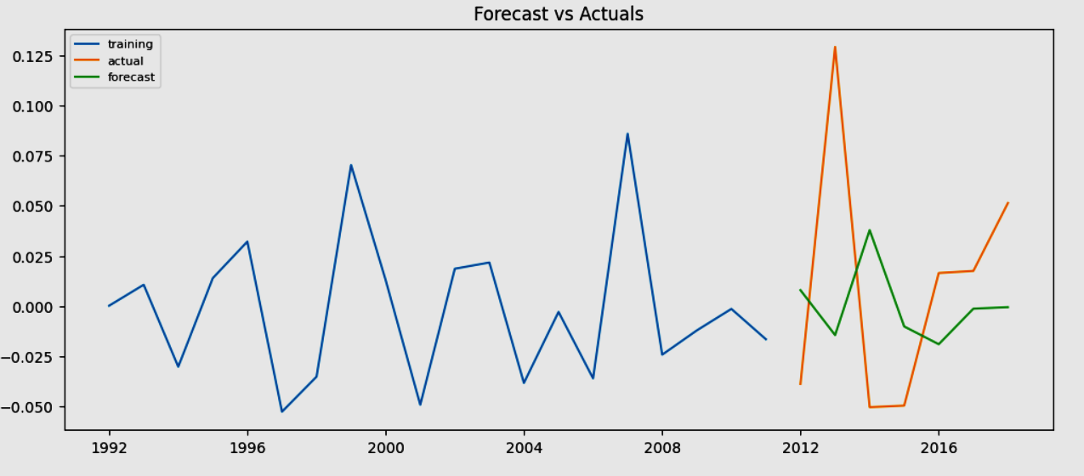
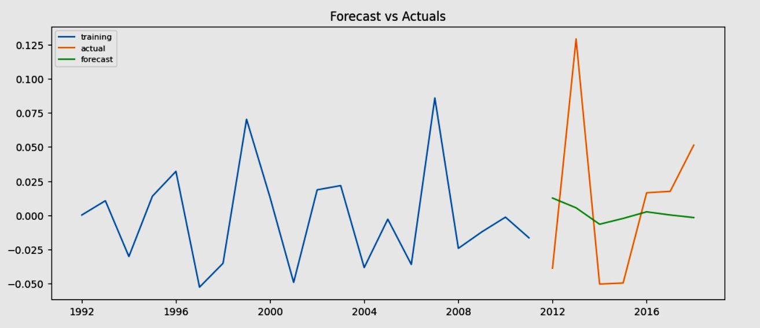
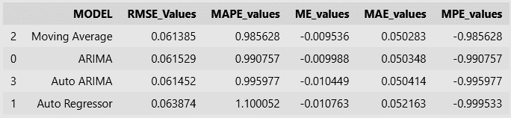
Model Performance Evaluation
CO2 emission from energy usage in buildings
Auto Regressor (final model)
ARIMA
12

Slide 14
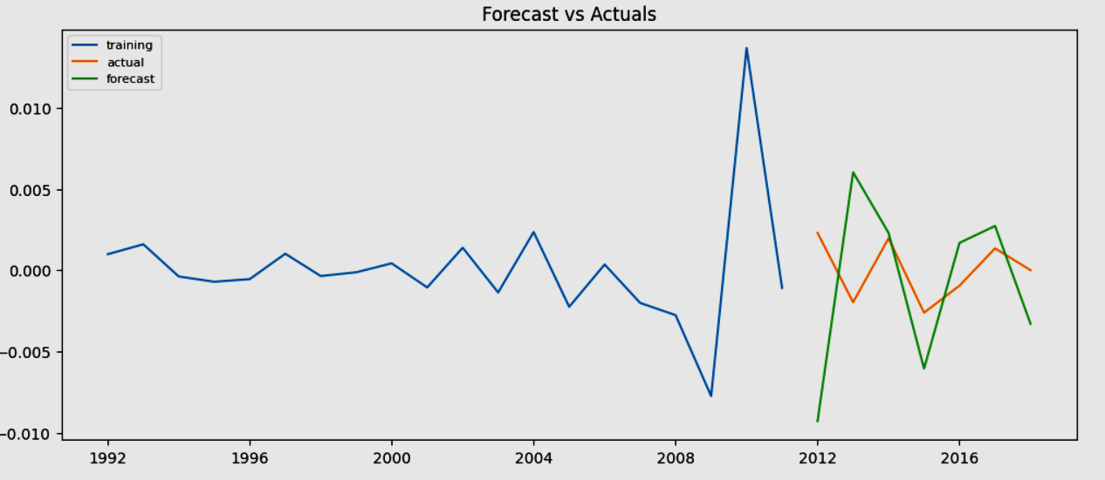
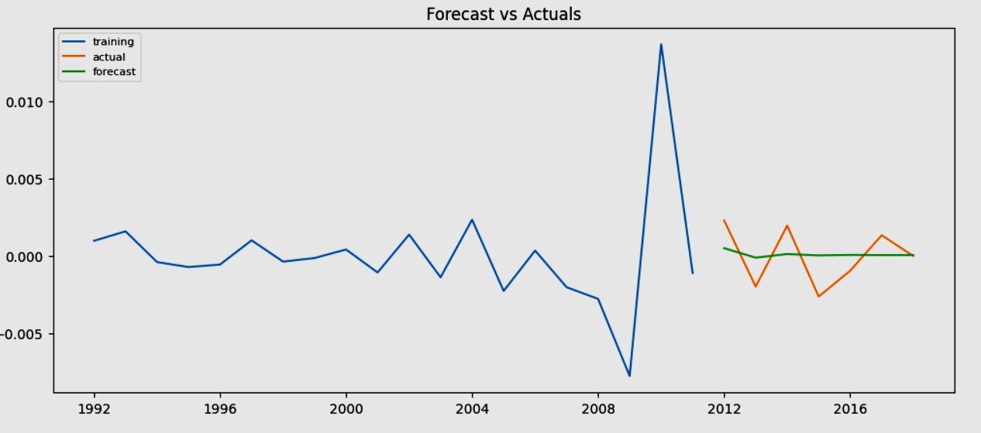
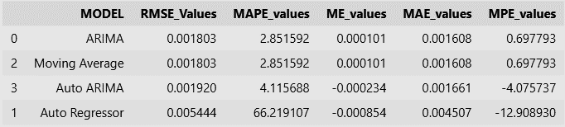
Model Performance Evaluation
CO2 emission from energy usage in industries
Auto Regressor
ARIMA (final model)
13

Slide 15
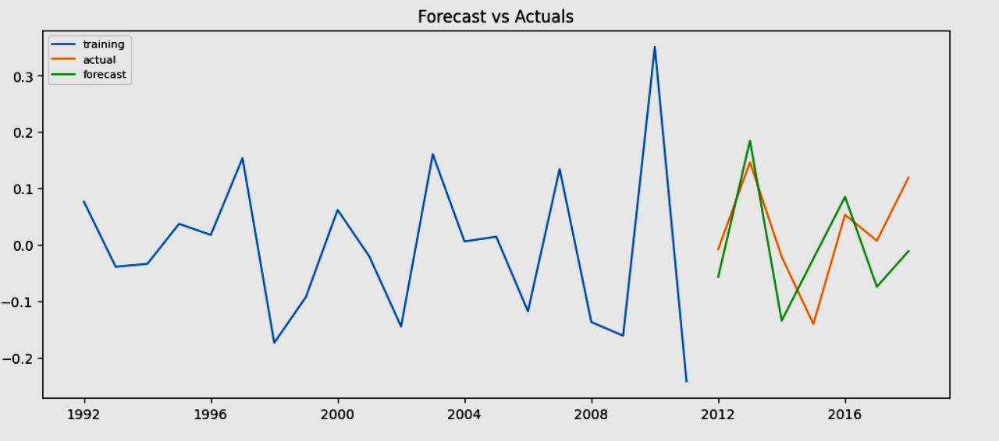
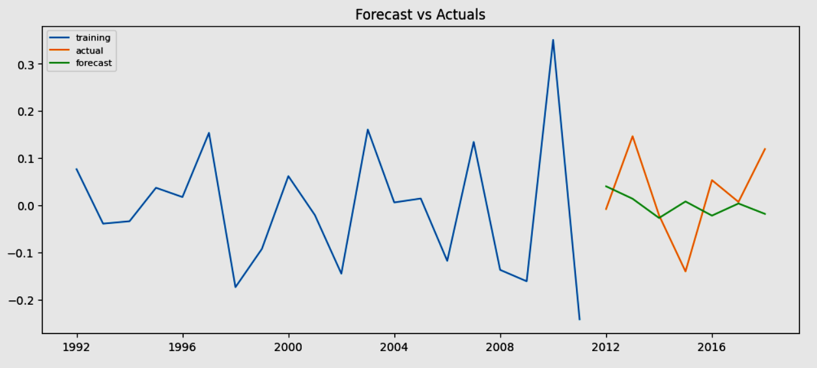
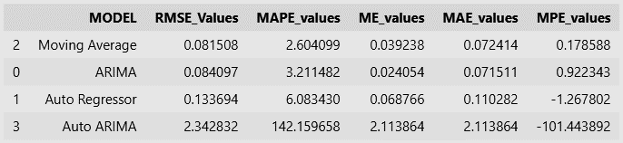
Model Performance Evaluation
CO2 emission from electricity and heat generation
Auto Regressor (final model)
ARIMA
14

Slide 16
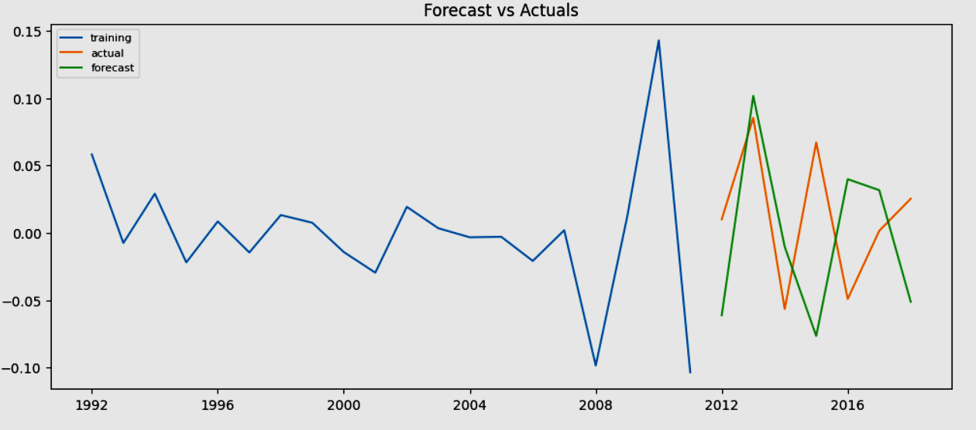
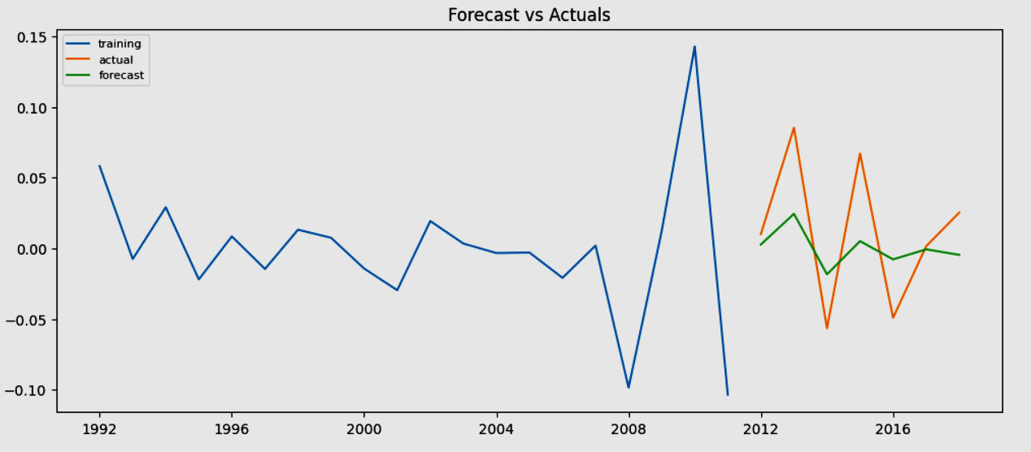
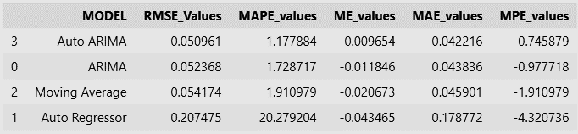
Model Performance Evaluation
CO2 emission from energy usage in transportations
Auto Regressor
ARIMA (final model)
15

Slide 17
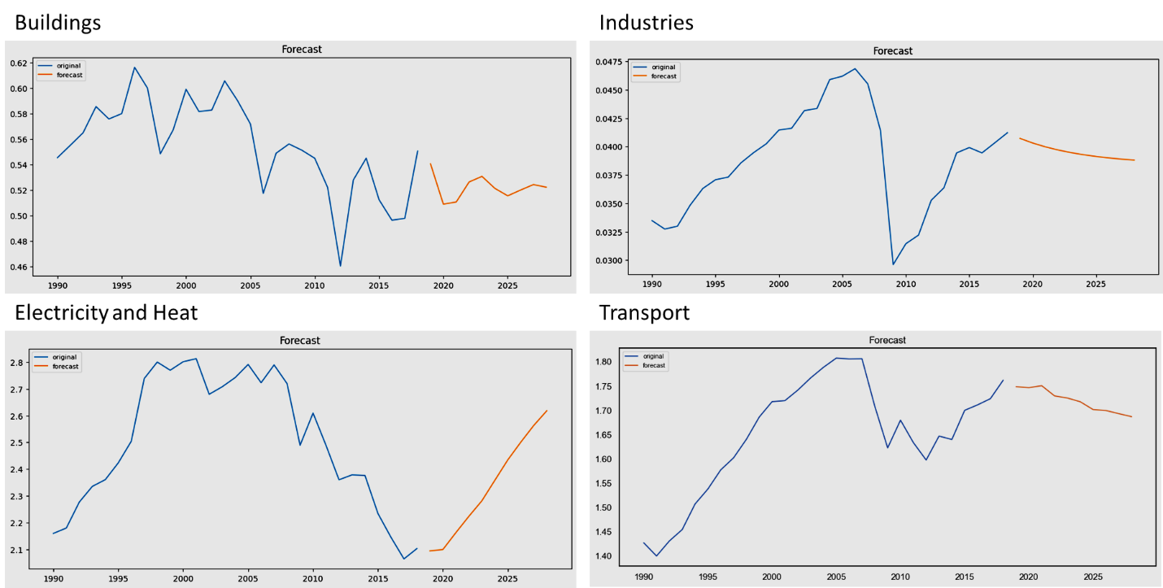
Forecasting Charts
Forecasted trends based on the selected models
16

Slide 18
Results
The forecasts are made based on the values of accuracy
Forecasts generated indicated the trends observed in 10 years
Forecast to be used for monitoring and control of emission to acceptable standards.
More focus must be directed towards alternative solutions in the electricity and heat sectors

Slide 19

Thanks

